Slide 1





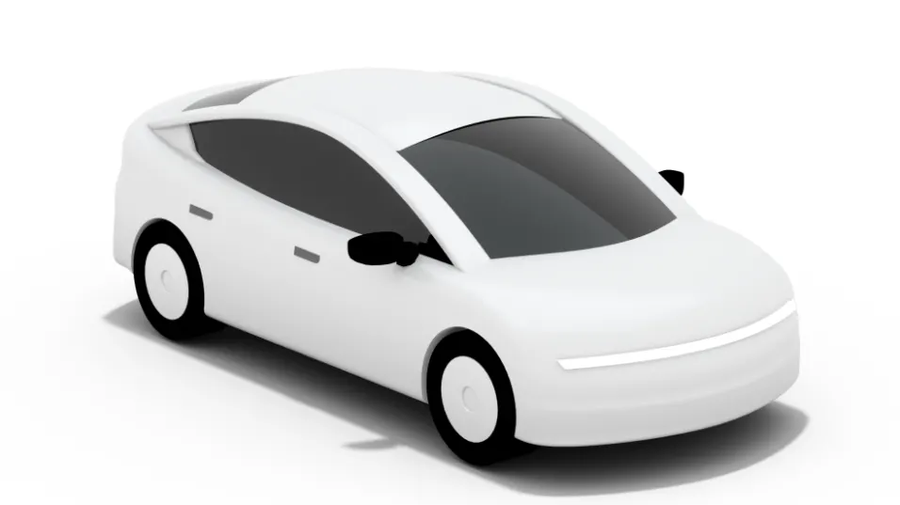
Behind Uber Drivers Stories
How have the stories of Uber drivers in the community forum changed since the beginning of Covid.
Group 15

Slide 2
Reasons Behind the chosen Forum
Web Scrapping and Final Data
To appreciate what Uber drivers talk about, we chose to analyse the Stories forum under Community.
Stories have 17.4m observers and 259k comments making it appropriate to extract at least 500 messages.
In this forum drivers are able to share any story they have experienced within their community and we believe it will be very interesting to observe what stories they share.
Our aim was to compare what topics have been shared the most in 2020 when Covid first started and what stories have been shared in 2021 were restrictions eased.
Following we performed Sentiment Analysis to see how the emotions of Stories change over the years
We performed Web Scrapping on 25 pages using the library Beautiful Soup
The first and the most important task is to clean the data as it ensures better accuracy results.
Overall the final dataset had 844 rows.
To perform Topic modelling we have split the data between the years 2020 and 2021 as we wanted to observe changes in Topics over the beginning of Covid until now.
For Sentiment Analysis we have used the whole dataset to observe changes in emotions.

Slide 3
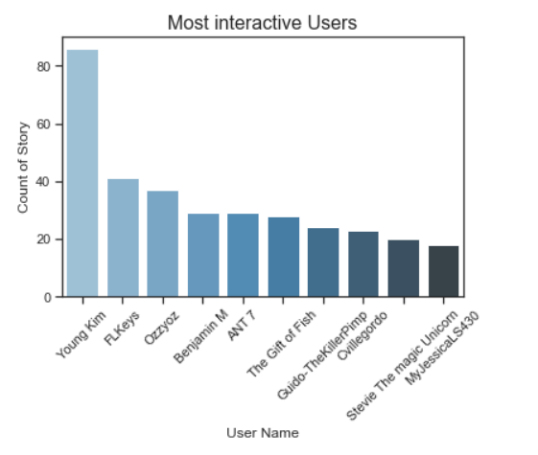
Data Insight
From the graph we can observe which drivers interact the most in the forum.
Young Kim is the most active driver and has a shared more than 80 stories in the forum.
The rest 9 most interactive users have shared stories ranging from the number 20 to 40.

Slide 4
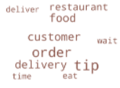
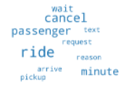
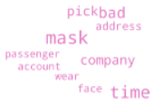
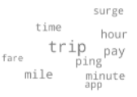
Topic Modeling 2020
Topic 1 – Food Orders
Topic 2 – Cancelations and Requests
Uber Eats is under Uber and drivers were talking about food delivery to customers and the tips they were getting.
Another popular story is about requests and cancels from passengers and the reasons behind any wait time when picking them up.
Topic 3 – Covid Regulations and bad experiences
Topic 4 – Trips and paying rate
Since it was the beginning of Covid, drivers were sharing stories about wearing face masks when picking up the customers and about some of the bad experiences they had with passengers.
Drivers were sharing stories about their pay rate per hour and fare and the time it took them for to complete a ride.

Slide 5
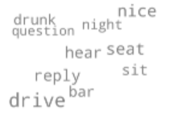
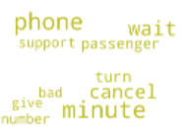
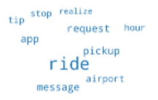
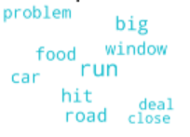
Topic Modeling 2021
Topic 1 – Night Outs
Topic 2- Passenger cancelations
Some stories that the drivers have shared concern night outs and people getting drunk at bars since restrictions have been eased and people were allowed to go out.
Topic 2 is very similar to Topic 2 in 2020. It seems that Uber drivers share a lot of stories about last minute cancelations and waiting for customers.
Topic 3 – Problems Facing
Topic 4 – Pickup Requests and rides
Some stories in 2021 concern picking up customers from airports and the messages drivers exchange with passengers through the app. Also we can see that they talk about tips and requests.
Topic 3 is about problems that drivers are faced with either with food and roads being close. Also they share stories about hit and run situations

Slide 6
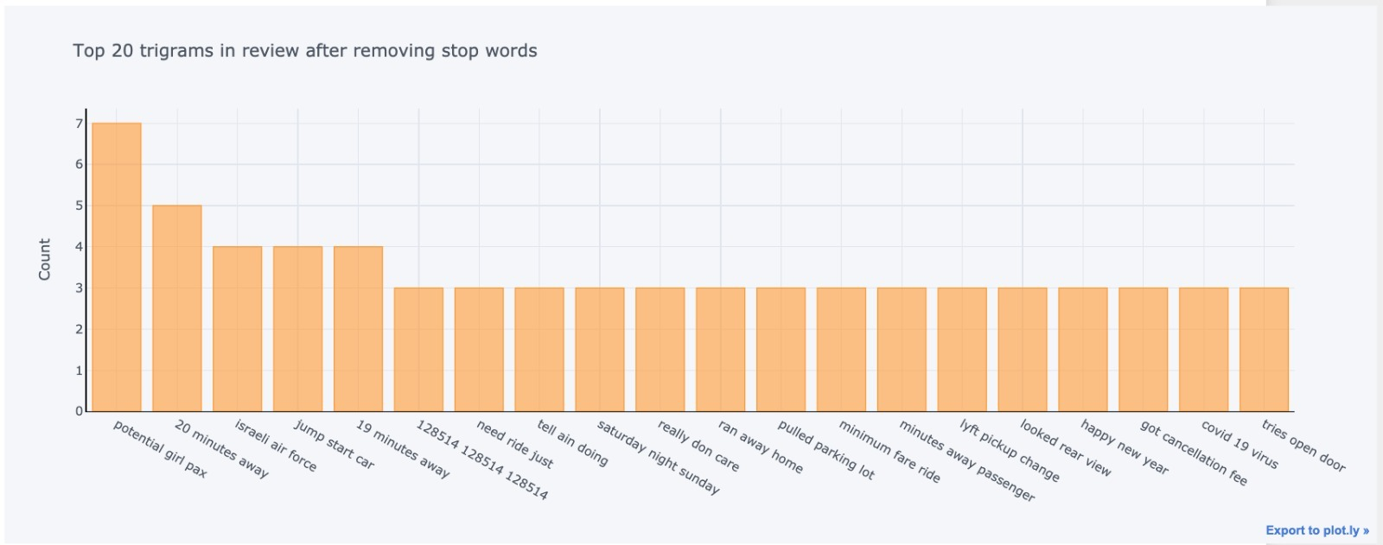
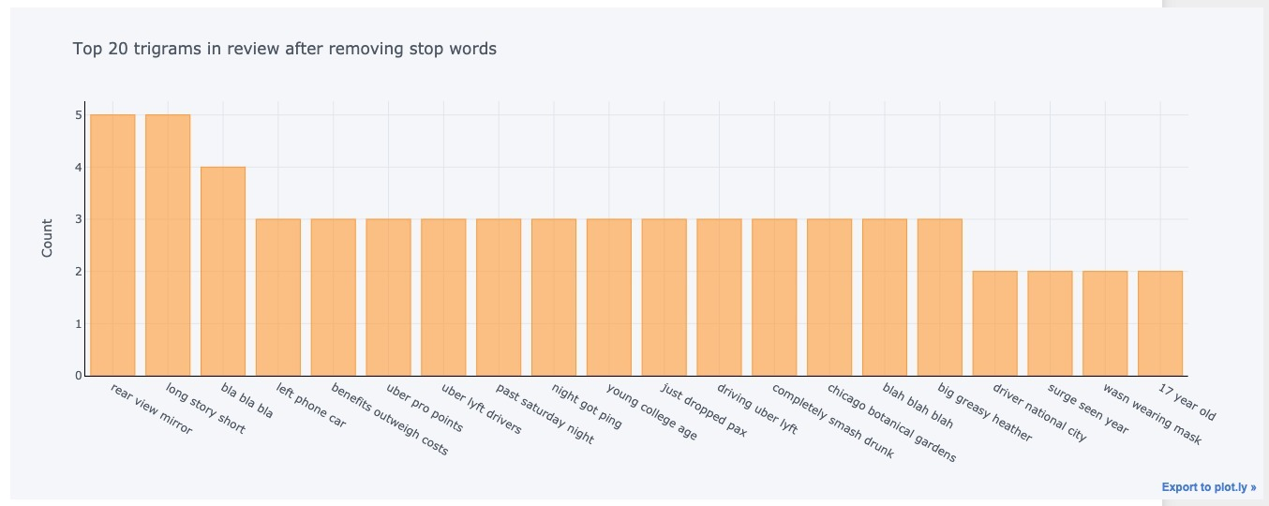
Top 20 trigrams
2020
2021

Slide 7
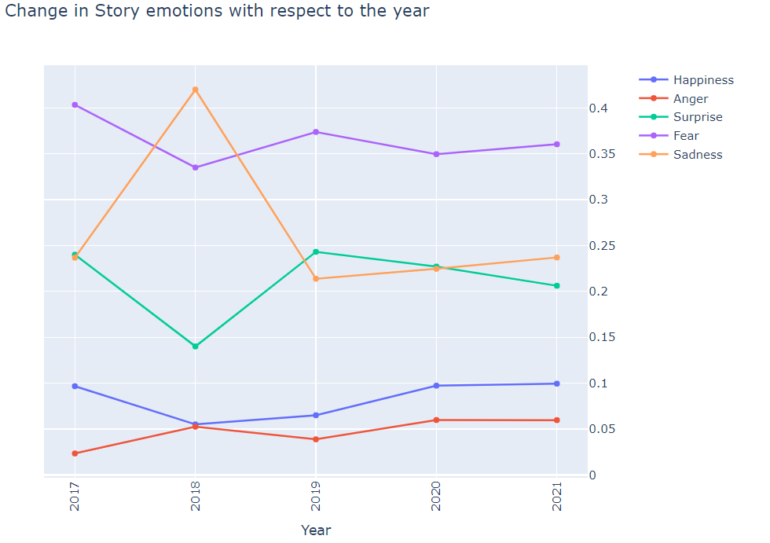
Sentiment Analysis
We have bifurcated all the Stories into general sentiment (positive, negative and neutral) and 5 different emotions such as happy, angry, surprise, fear and sadness.
From the graph we can observe how emotions in the stories have changed from 2017 to 2021.
We can observe a slight increase in anger over the years.
Happiness has slightly increase from 2018 to 2020 but remained constant until 2021 when Covid was present.
Surprise saw an increase in 2018 to 2019 but then felt again until 2021.
Overall fear has slightly increase since the beginning of Covid but we can observe that in 2017 it was much higher.
Sadness was at a peak in 2018 and then felt a lot, but we can see a slight increase in the year 2020 to 2021

Slide 8
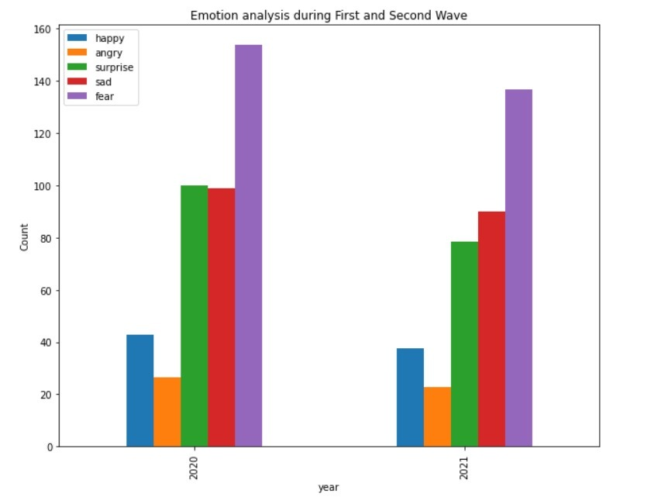
Emotion Analysis Between First and Second Wave of Covid
Overall fear, sadness and surprise have decreased.
In 2020 fear was high since Covid was new to the world. In 2021 a vaccine was introduced and thus the overall fear in stories shared has dropped.
Happiness and anger have remained the same in the stories shared between the years.

Slide 9
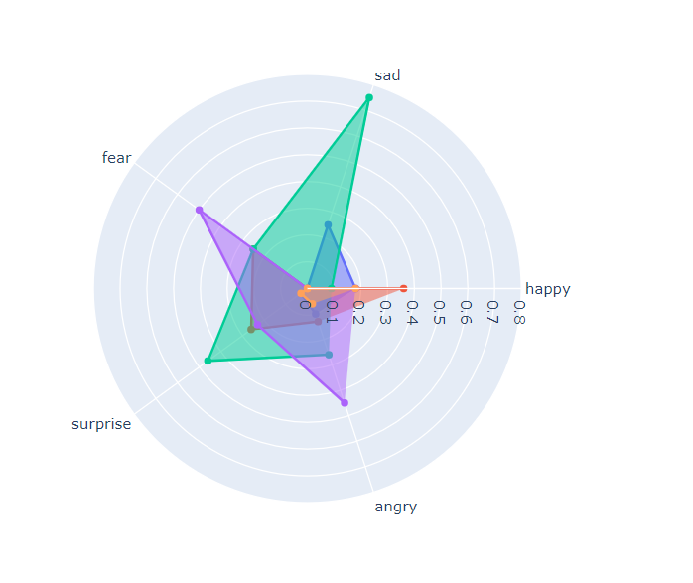
Emotion Analysis Between First and Second Wave of Covid
Here we can observe which variables are scoring high or low in our dataset from 2020 to 2021.
The range of the emotions vary from 0 to 1 and sad scores 0.8.
Sad and Fear seem to be the dominant emotions out of all 5. We can observe that the stories uber drivers share show fear and sadness.

Slide 10
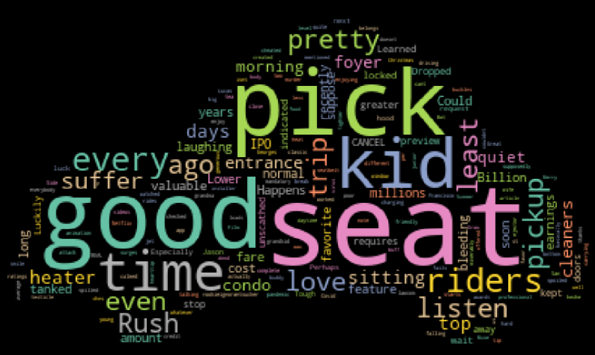
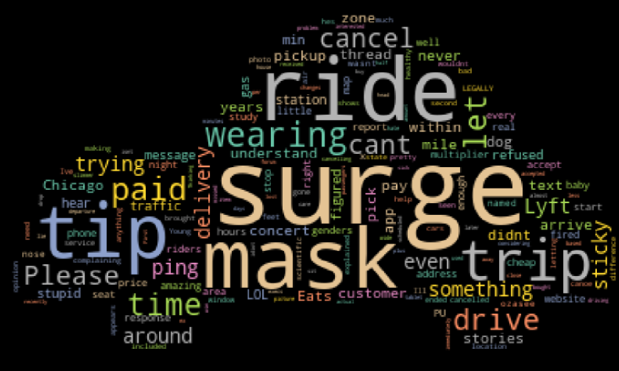
Which words appear the most in Stories expressing Happiness and Saddens.
Happy
Sad

Slide 11
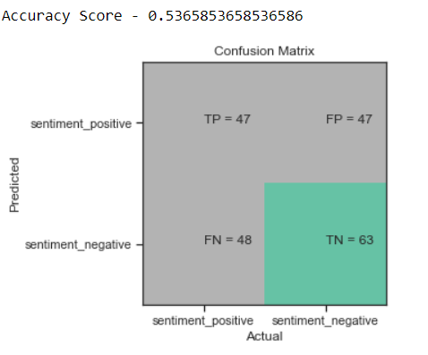
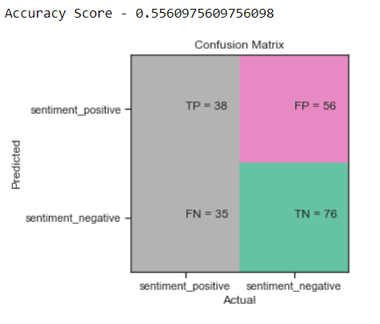
Statistical Analysis
TF-IDF word features
Naïve Bayes Classification
We converted textual representation in the form of numeric features. We performed feature extraction using:
Bag of words (Simple vectorization)
TF-IDF (Term Frequency - Inverse Document Frequency)
We declare the features using the CountVectorizer function
Firstly we cleaned the stories and found ‘Key word’ based features.
Then we splitting the data into Training data(75%) and Testing data(25%)
We apply the Naïve Bayes Classification model and fit it with the training data.
Features extracted from 'key words' helps model in performing better. But BOW is better in prediction than TF-IDF approach.
Limitations:
Naive Bayes assumes that all features are independent, rarely happening in real life, which is why it neglects neutral sentiments.
BOW word features

Slide 12
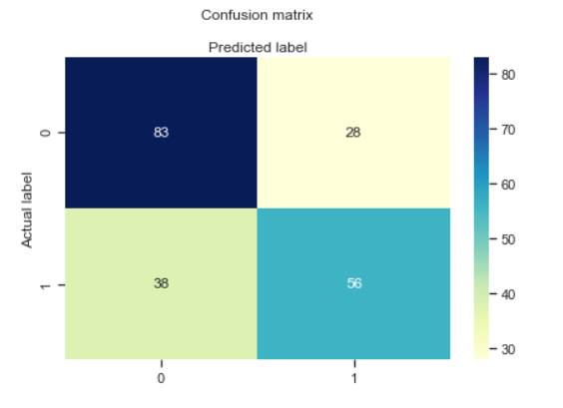
Statistical Analysis
Logistic Regression
We begun with splitting the data into Training data (75%) and Testing data (25%).
The training data was used to train the model and the model was tested using the testing data.
We applied the Logistic Regression model and fitted it with the training data.
Once the data was trained, we tested it by giving the testing data as input.
We got an Accuracy of 0.68
Accuracy: 0.6780487804878049

